Slide 1
Let’s take a break! Stretch, go for a walk, be social ☺ Be back here in 10 mins.

Slide 2
Focus+Context

Slide 3
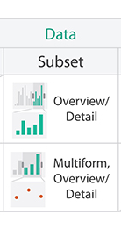
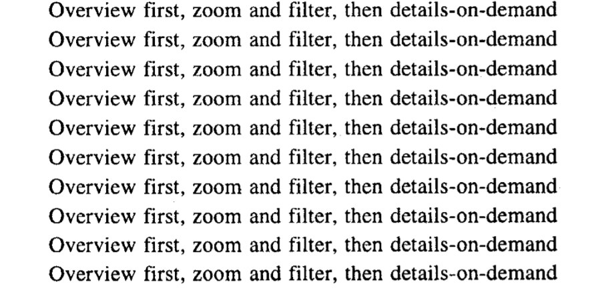
Remember this?
- Ben Shneiderman
Shneiderman, 1996
Notes:
We first mentioned this type of design when we talked about design rules of thumb, and then again in more detail when we talked about faceting and arranging data in a visualization.
<next>

Slide 4
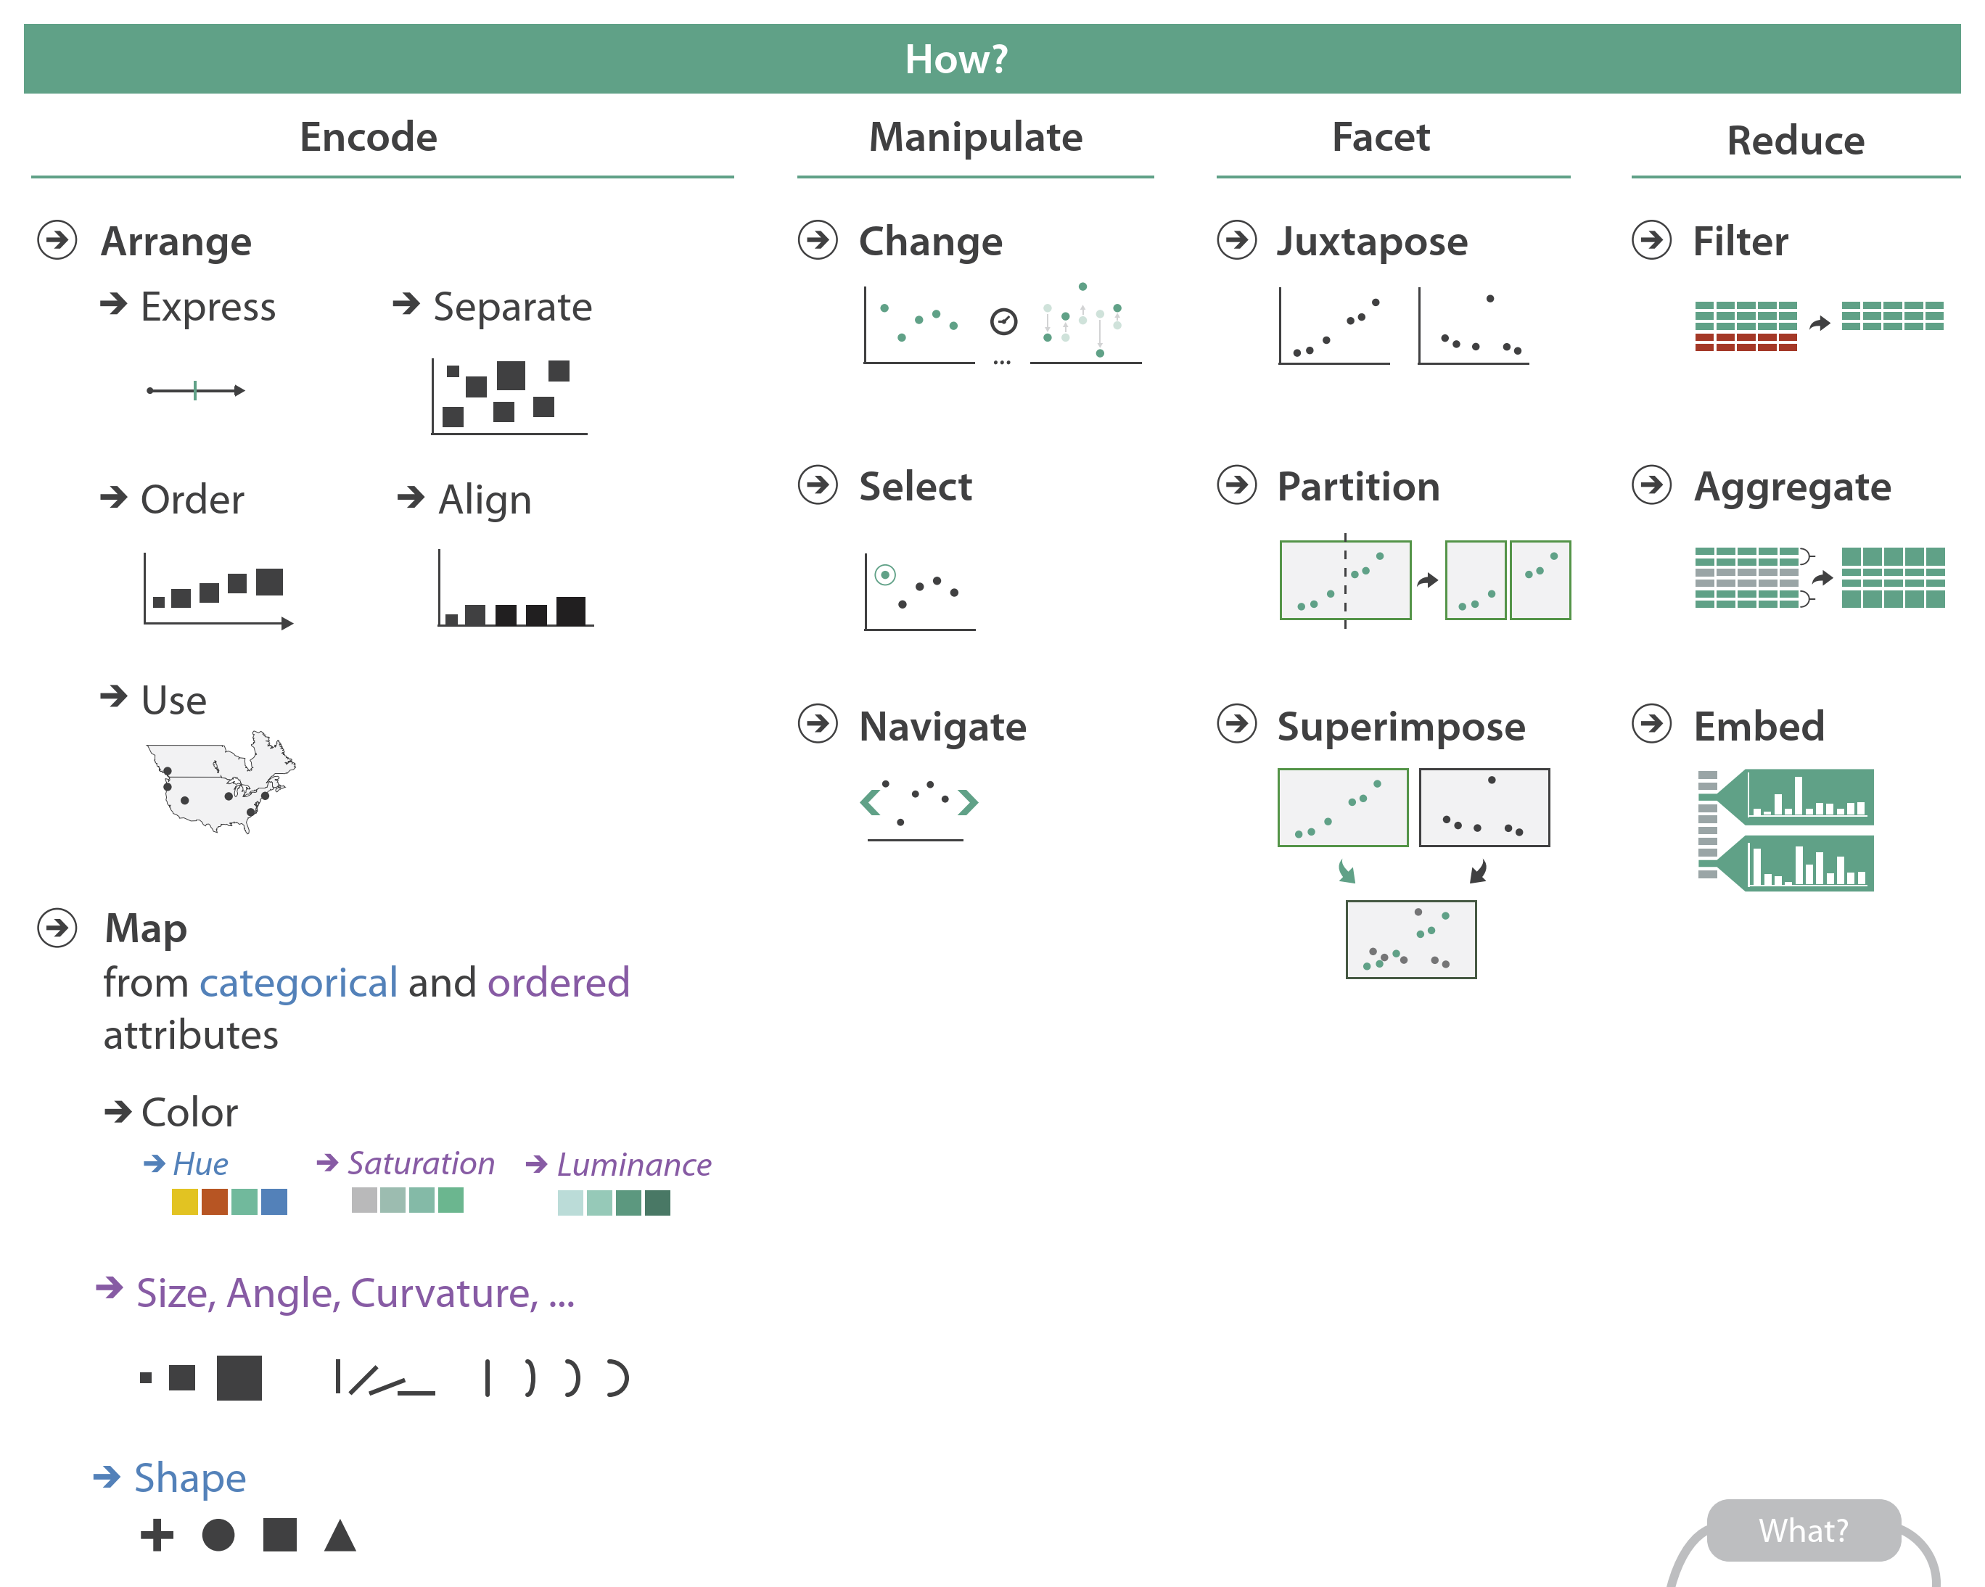
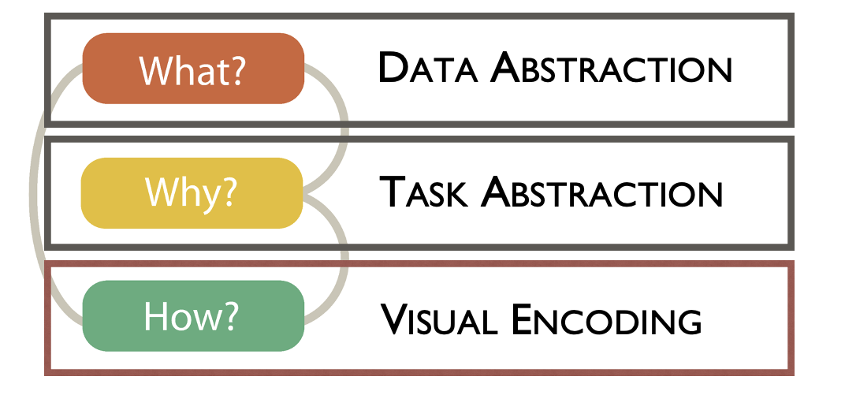
Munzner’s Design Pipeline
From Munzner’s book
Notes:
Let’s start by looking at reduction techniques fit into Munzner’s design pipeline.
We talked about reduction briefly when we looked at Navigate interactions.
Today we’ll look more in-depth at reduction at its own step in the design pipeline.

Slide 5
Focus + Context
A Focus+Context visualization is a visualization designed such that:
It shows an overview of data (maybe using combined tactics of filtering and aggregation)
AND
It allows users to select a region of interest within the overview to see more detailed information
Based on Slide by M. Meyer
Notes:
Read

Slide 6
Focus + Context
A Focus+Context visualization is a visualization designed such that:
It shows an overview of data (maybe using combined tactics of of filtering and/or aggregation [Caution: You should carefully pick what to show and hint at what you are not showing])
AND
It allows users to select a region of interest within the overview to see more detailed information
Based on Slide by M. Meyer
Notes:
And just a reminder to be cautious when designing your overview about what data you choose to show versus hide, and making sure that you hint to the user what data is being hidden.
Let’s look at a few classic examples of Focus+Context visualizations.

Slide 7
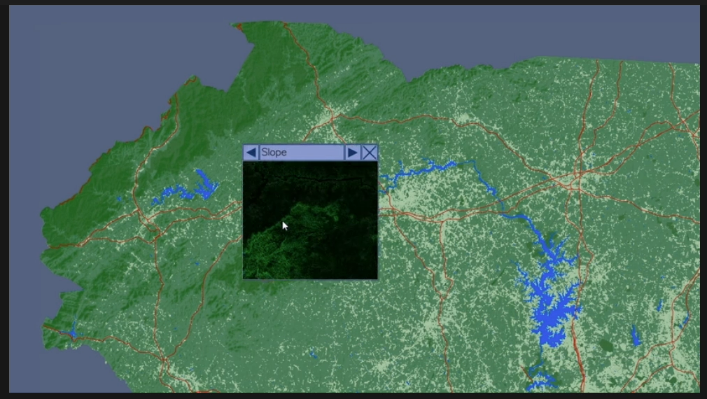
Focus + Context
Magic
Lens
https://www.youtube.com/watch?v=u1Pq_o67wvI
Based on Slide by M. Meyer
Notes:
Here’s an example with Geospatial data. This visualization shows an overview of many layers of geospatial data,
and allows the user to investigate individual layers of the data for a specific region using an interactive lens.
In this example, the map provides context, and the magic lens provides focus.

Slide 8
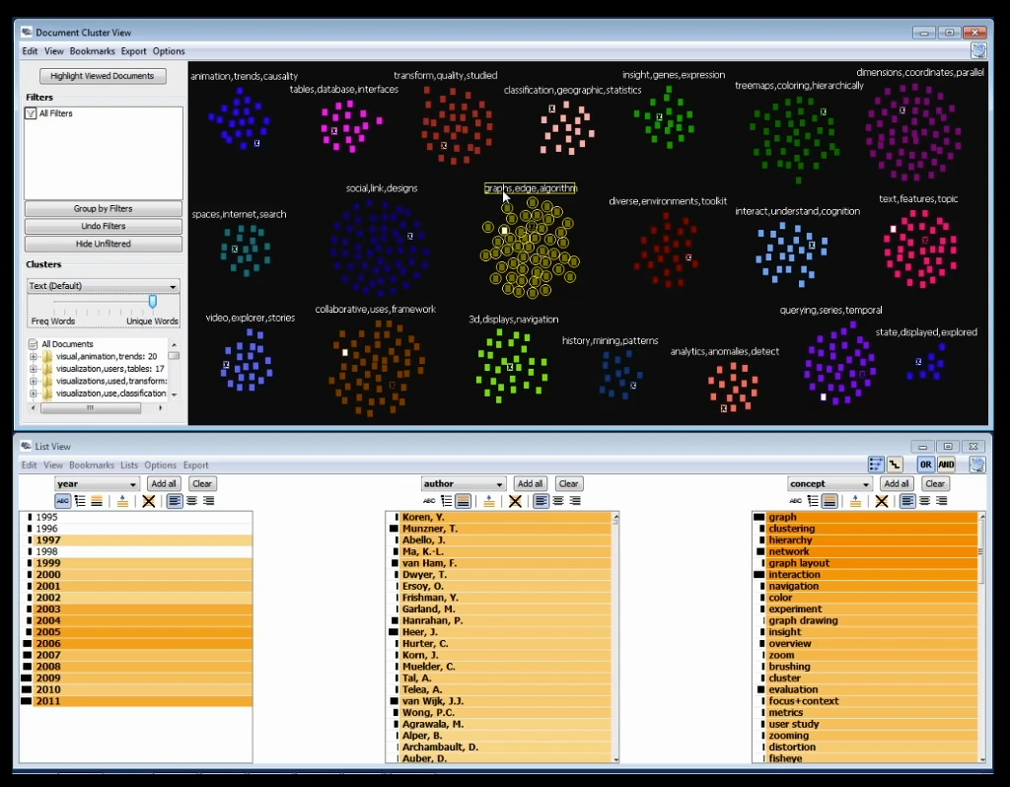
Focus + Context
Jigsaw
https://www.cc.gatech.edu/gvu/ii/jigsaw/
Notes:
Here’s another example, that visualizes documents.
This visualization includes a lot of features, but notably, it provides an overview of documents through a cluster view at the top, and allows the user to investigate specific clusters more thoroughly through various focused or detailed views.
In this example, the clusters of documents are the context, and the list and pop out views are the focus.

Slide 9
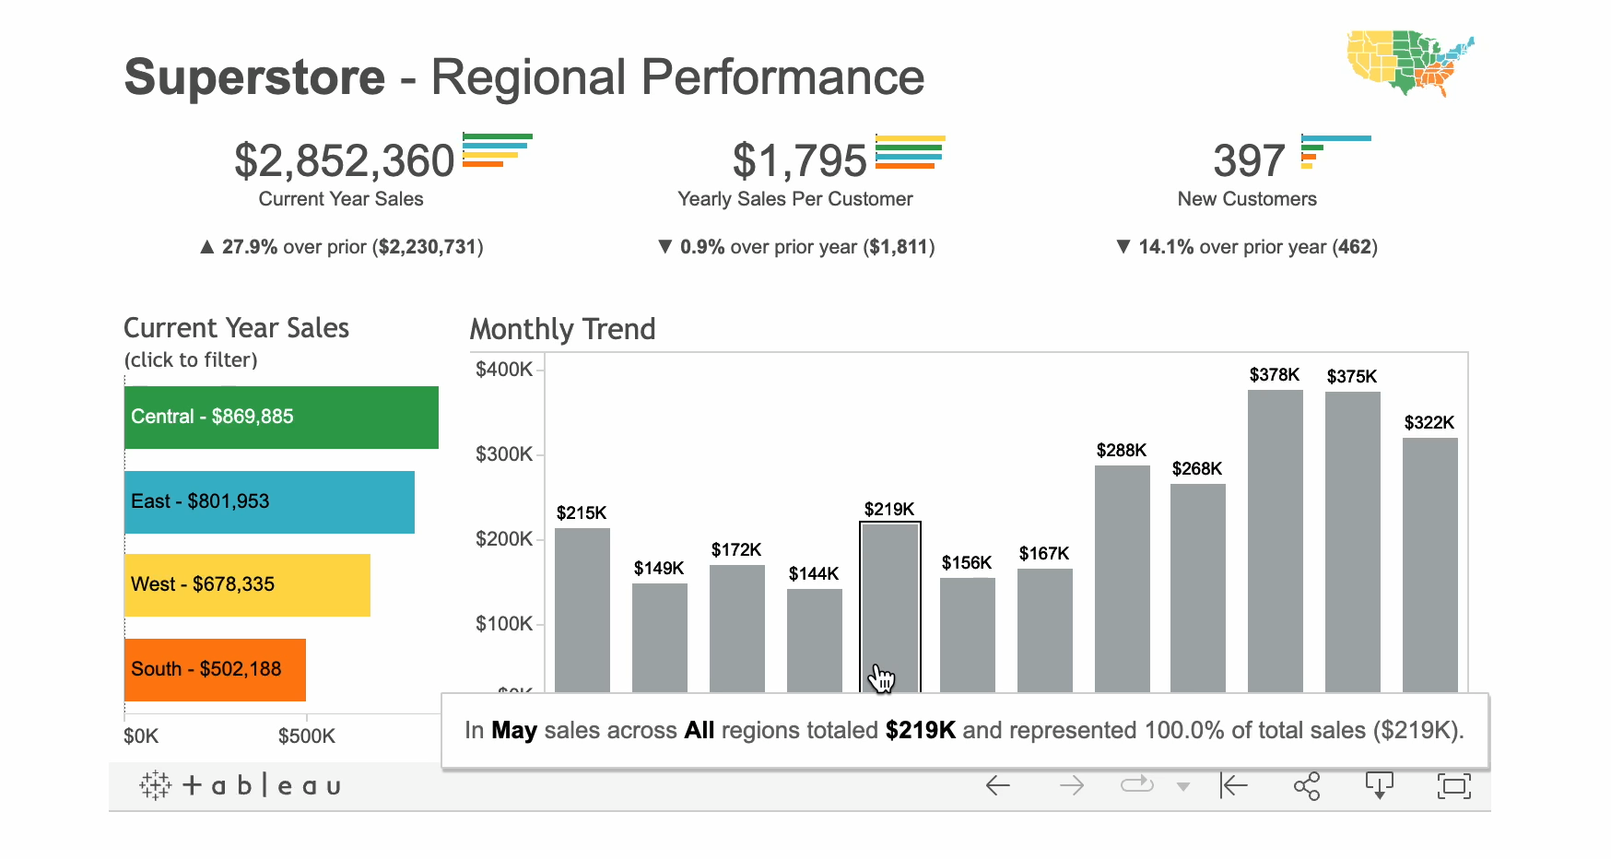
Focus + Context
https://www.tableau.com/about/blog/2016/5/information-demand-54621
Notes:
Here’s another example, that visualizes documents.
This visualization includes a lot of features, but notably, it provides an overview of documents through a cluster view at the top, and allows the user to investigate specific clusters more thoroughly through various focused or detailed views.
In this example, the clusters of documents are the context, and the list and pop out views are the focus.

Slide 10
Focus + Context
https://public.tableau.com/app/profile/hivizfigs/viz/Pitt5/Dashboard1
Notes:
Here’s another example, that visualizes documents.
This visualization includes a lot of features, but notably, it provides an overview of documents through a cluster view at the top, and allows the user to investigate specific clusters more thoroughly through various focused or detailed views.
In this example, the clusters of documents are the context, and the list and pop out views are the focus.

